Slide 1

Car Market Trends Analysis
STU6a6ccd17eea6d1785515287
DHANASEELAN R

Slide 2

PROBLEM STATEMENT
Dynamic Resale Market: Used car prices fluctuate significantly across multi-dimensional parameters including manufacturing year, distance driven, fuel category, and transmission type.
​Pricing Inefficiencies: Asymmetric information causes buyers to overpay and independent sellers to misprice inventory without data-backed benchmarks.
​Core Objective: Mine historical market listings to uncover key pricing factors, identify depreciation patterns, and establish standard valuation metrics.

Slide 3
Project Description
​
Dataset Scope: Analyzed 301 vehicle records containing 9 attributes (Showroom Price, Selling Price, Odometer Kilometers, Fuel Type, Transmission, Seller Type, and Prior Owners).
​Exploratory Data Analysis (EDA): Quantified price degradation across vehicle age groups and evaluated mileage wear-and-tear effects. ​Market Segmentation: Identified pricing variances across
transmission mechanisms (Manual vs. Automatic), fuel variants (Diesel, Petrol, CNG), and sales channels (Dealer vs. Individual).

Slide 4

WHO ARE THE END USERS?
Automobile Buyers: Individual consumers seeking transparent benchmark prices to negotiate fair deals. ​Dealerships & Used Car Aggregators: Commercial resellers aiming to optimize listing margins, turn over inventory faster, and price cars competitively.
​Fintech & Insurance Providers: Auto lenders and insurance underwriters needing accurate residual value estimates for loan-to-value (LTV) and policy calculations.

Slide 5

Technology Used
​Language: Python
​Data Processing & Analytics: Pandas, NumPy
​Visualization: Matplotlib, Seaborn ​Development Environment: Jupyter Notebook / VS Code

Slide 6
RESULTS
The following screenshots present the outputs generated during the analysis.
Github link : https://github.com/dhanaseelan-r4/Car-Market-Trends-Analysis

Slide 7
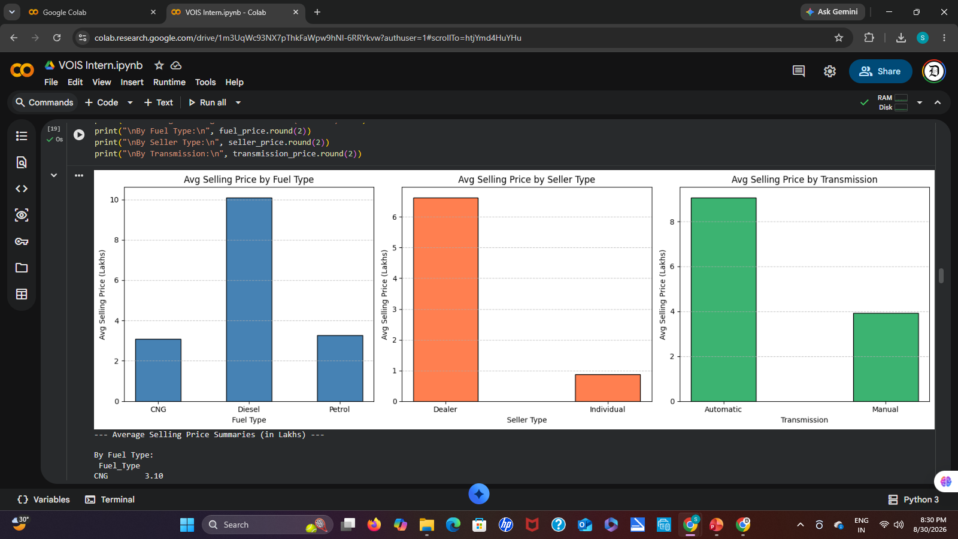

Slide 8
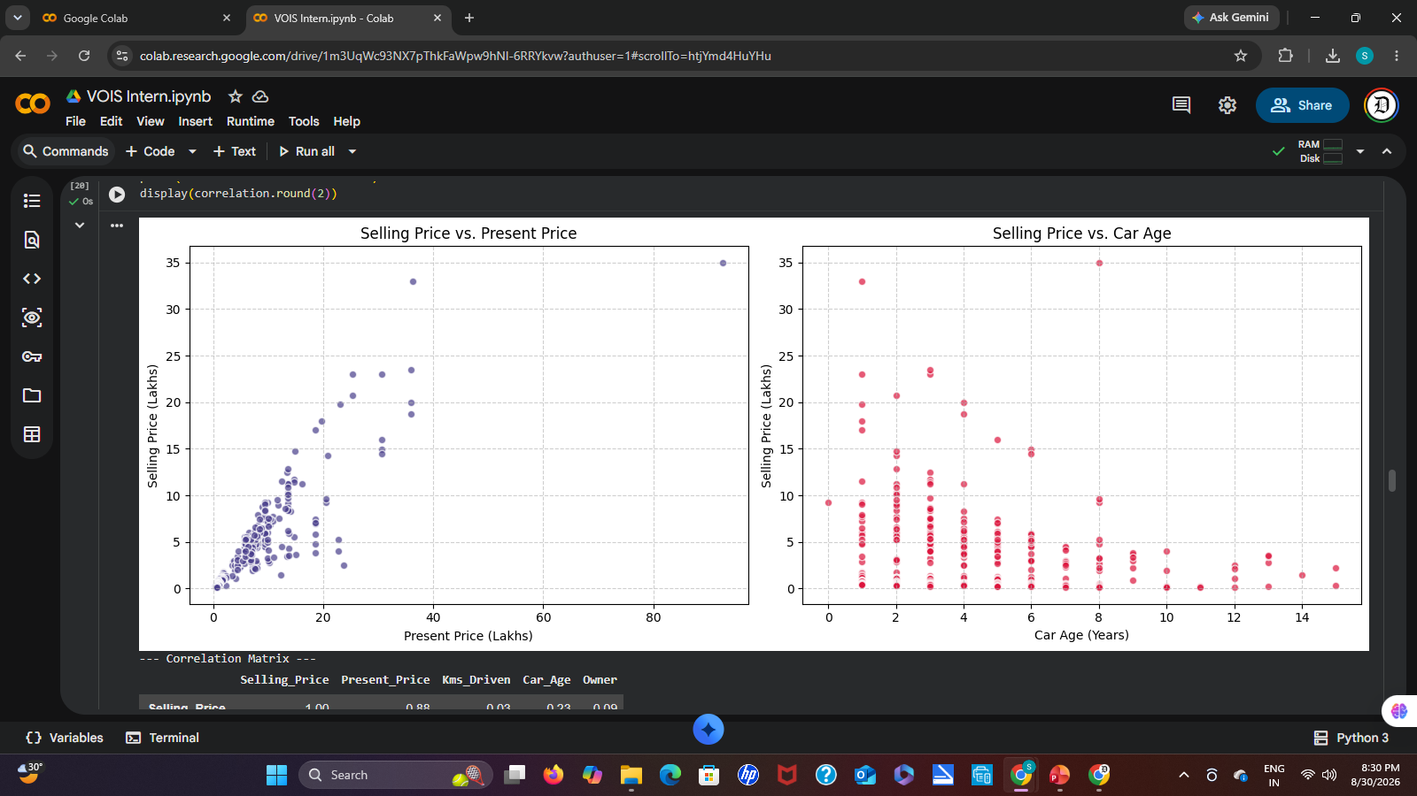

Slide 9
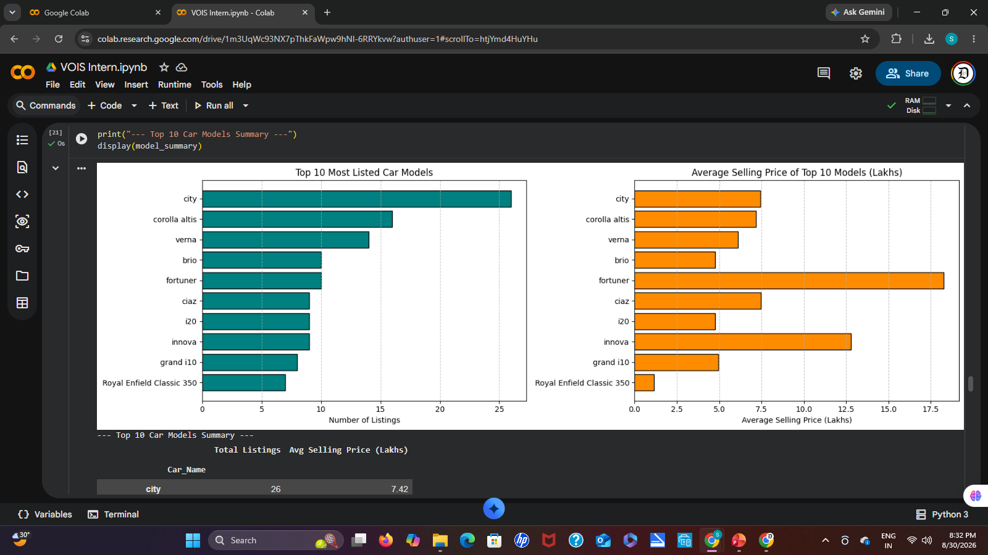

Slide 10
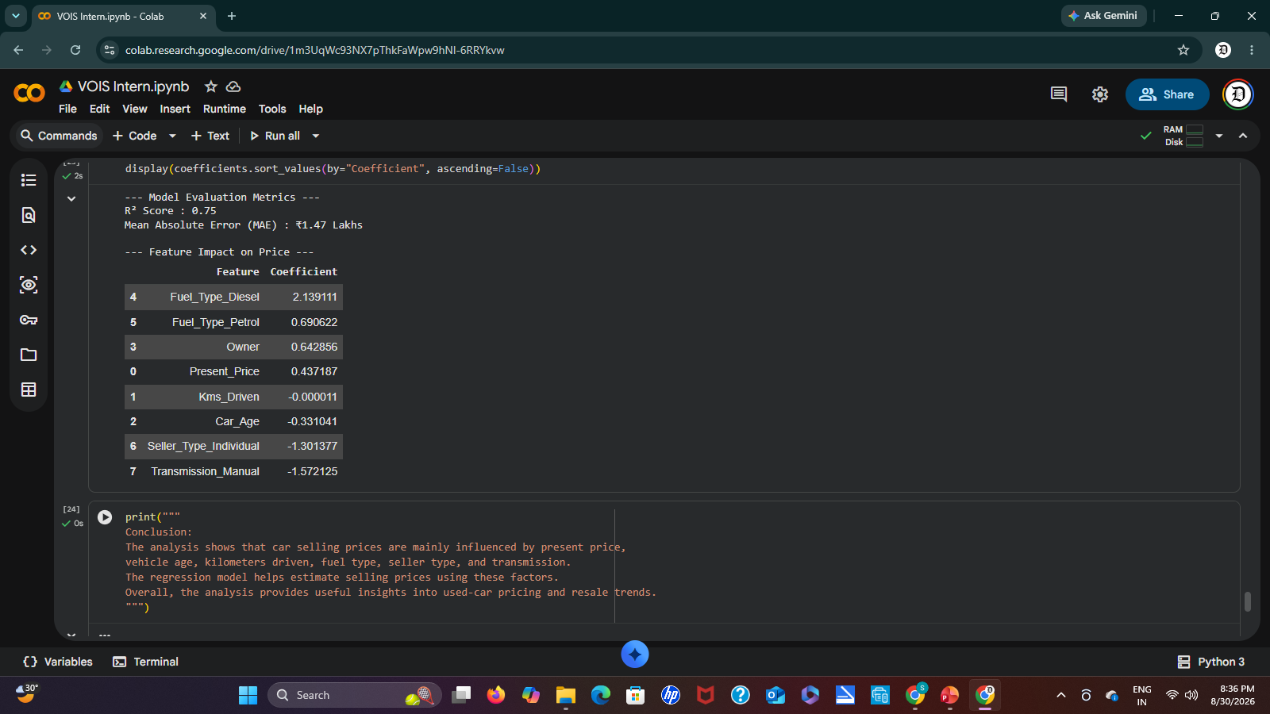

Slide 11
Thank you
I appreciate your time and attention. It was a pleasure presenting this analysis.
.
.

